Slide 1
HIGH-SPEED LANS
DEPARTMENT OF COMPUTER SCIENCE, SARDAR PATEL UNIVERSITY, V. V. NAGAR.
SATELLITE NETWORKS :
Although most multiple access channels are found in LANs, one kind of WAN also uses multiple access channels : communication satellite based WANs.
Communication satellites generally have up to a dozen or so transponders. Each transponder has a beam that covers some portion of the earth below it, ranging from a wide beam 10,000 km across to a spot beam only 250 km across. Stations within the beam area can send frames to the satellite on the uplink frequency. The satellite then rebroadcasts them on the downlink frequency. Different frequencies are used for uplink and downlink to keep the transponder from going into oscillation. Satellites that do no on-board processing, but just echo whatever they hear (most of them), are often called bent pipe satellites.

Slide 2
HIGH-SPEED LANS
DEPARTMENT OF COMPUTER SCIENCE, SARDAR PATEL UNIVERSITY, V. V. NAGAR.
Each antenna can aim itself at some area, transmit some frames, and then aim at a new area. Aiming is done electronically, but still takes some number of microseconds. The amount of time a beam is pointed to a given area is called the dwell time. For maximum efficiency, it should not be too short or too much time will be wasted moving the beam.
Just as with LANs, one of the key design issues is how to allocate the transponder channels. However, unlike LANs, carrier sensing is impossible due to the 270-msec propagation delay. When a station senses the state of a downlink channel, it hears what was going on 270 msec ago. Sensing the uplink channel is generally impossible. Five classes .of protocols are used on the multiple access (uplink) channel: polling, ALOHA, FDM, TDM, and CDMA.

Slide 3
HIGH-SPEED LANS
DEPARTMENT OF COMPUTER SCIENCE, SARDAR PATEL UNIVERSITY, V. V. NAGAR.
POLLING :
The traditional way to allocate a single channel among competing users is for somebody to poll them. Having the satellite poll each station. in turn to see if it has a frame is prohibitively expensive, given the 270-msec time required for each poll/response sequence.
However, if all the ground stations are also tied to a (typically low-bandwidth) packet-switching network, a minor variation of this idea is conceivable. The idea is to arrange all the stations in a logical ring, so each station knows its successor. Around this terrestrial ring circulates a token. The satellite never sees the token. A station is allowed to transmit on the uplink only when it has captured the token. If the number of stations is small and constant, the token transmission time is short, and the bursts sent on the uplink channel are much longer than the token rotation time, the scheme is moderately efficient.

Slide 4
HIGH-SPEED LANS
DEPARTMENT OF COMPUTER SCIENCE, SARDAR PATEL UNIVERSITY, V. V. NAGAR.
ALOHA :
Pure ALOHA is easy to implement: every station just sends whenever it wants to. The trouble is that the channel efficiency is only about 18 percent. Generally, such a low utilization factor is unacceptable for satellites that costs tens of millions of dollars each.
Using slotted ALOHA doubles the efficiency but introduces the problem of how to synchronize all the stations so they all know when each time slot begins. Fortunately, the satellite itself holds the answer, since it is inherently a broadcast medium. One ground station, the reference station, periodically transmits a special signal whose rebroadcast is used by all the ground stations as the time origin. If the time slots all have length T, each station now knows that time slot k begins at a time kT after the time origin. Since clocks run at slightly different rates, periodic resynchronization is necessary to keep everyone in phase. An additional complication is that the propagation time from the satellite is different for each ground station, but this effect can be corrected for.

Slide 5
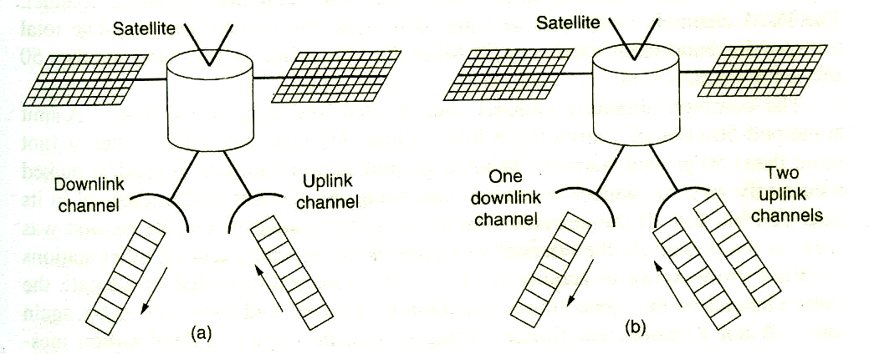
HIGH-SPEED LANS
DEPARTMENT OF COMPUTER SCIENCE, SARDAR PATEL UNIVERSITY, V. V. NAGAR.
To increase the utilization of the uplink channel above 1/e, we could go from the single uplink channel of Fig. (a), to the dual uplink scheme of Fig. (b). A station with a frame to transmit chooses one of the two uplink channels at random and sends the frame in the next slot. Each uplink then operates an independent slotted ALOHA channel.

Slide 6
HIGH-SPEED LANS
DEPARTMENT OF COMPUTER SCIENCE, SARDAR PATEL UNIVERSITY, V. V. NAGAR.
If one of the uplink channels contains a single frame, it is just transmitted in the corresponding downlink slot later. If both channels are successful, the satellite can buffer one of the frames and transmit it during an idle slot later on. Working out the probabilities, it can be shown that given an infinite amount of buffer space, the downlink utilization can be gotten up to 0.736 at a cost of increasing the bandwidth requirements by one half.

Slide 7
HIGH-SPEED LANS
DEPARTMENT OF COMPUTER SCIENCE, SARDAR PATEL UNIVERSITY, V. V. NAGAR.
FDM :
Frequency division multiplexing is the oldest and probably still the most widely used channel allocation scheme. A typical 36-Mbps transponder might be divided statically into 500 or so 64,OOO-bps PCM channels, each one operating at its own unique frequency to avoid interfering with the others.
Although simple, FDM also has some drawbacks. First, guard bands are needed between the channels to keep the stations separated. This requirement exists because it is not possible to build transmitters that output all their energy in the main band and nothing in the side bands. The amount of bandwidth wasted in the guard bands can be a substantial fraction of the total.
Second, the stations must be carefully power controlled. If a station puts out too much power in the main band, it will also automatically put out too much power in the side bands, spilling over into adjacent channels and causing interference. Finally, FDM is entirely an analog technique and does not lend itself well to implementation in software.

Slide 8
HIGH-SPEED LANS
DEPARTMENT OF COMPUTER SCIENCE, SARDAR PATEL UNIVERSITY, V. V. NAGAR.
If the number of stations is small and fixed, the frequency channels can be allocated statically in advance. However, if the number of stations, or the load on each one can fluctuate rapidly, some form of dynamic allocation of the frequency bands is needed. One such mechanism is the SPADE system used on some early Intelsat satellites. Each SPADE transponder was divided into 794 simplex (64­kbps) PCM voice channels, along with a 128-kbps common signaling channel. The PCM channels were used in pairs to provide full duplex service. The total transponder bandwidth used was 50 Mbps for the uplink portion and another 50 Mbps for the downlink.

Slide 9
HIGH-SPEED LANS
DEPARTMENT OF COMPUTER SCIENCE, SARDAR PATEL UNIVERSITY, V. V. NAGAR.
The common signaling channel was divided into units of 50 msec. A unit contained 50 slots of 1 msec (128 bits). Each slot was "owned" by one of (not more than) 50 ground stations. When a ground station had data to send, it picked a currently unused channel at random and wrote the number of that channel in its next 128-bit slot. If the selected channel was still unused when the request was seen on the downlink, the channel was considered allocated and all other stations refrained from trying to acquire it. If two or more stations tried to allocate the same channel in the same frame, a collision occurred and they had to try again later. When a station was finished using its channel, it sent a deallocation message in its slot on the common channel.

Slide 10
HIGH-SPEED LANS
DEPARTMENT OF COMPUTER SCIENCE, SARDAR PATEL UNIVERSITY, V. V. NAGAR.
TDM :
Like FDM, TDM is well understood and widely used in practice. It requires time synchronization for the slots, but this can be provided by a reference station, as described for slotted ALOHA above. Similarly to FDM, for a small and unvarying number of stations, the slot assignment can be set up in advance and never changed, but for a varying number of stations, or a fixed number of stations with time-varying loads, time slots must be assigned dynamically.

Slide 11
HIGH-SPEED LANS
DEPARTMENT OF COMPUTER SCIENCE, SARDAR PATEL UNIVERSITY, V. V. NAGAR.
Slot assignment can be done in a centralized or a decentralized way. As an example of centralized slot assignment, let us consider the experimental ACTS (Advanced Communication Technology Satellite), which was designed for a few dozen stations ACTS was launched in 1992 and has four independent 110-Mbps TOM channels, two uplink and two downlink. Each channel is organized as a sequence of 1-msec frames, each frame containing 1728 time slots. Each time slot has a 64-bit payload, allowing each one to hold a 64-kbps voice channel.

Slide 12
HIGH-SPEED LANS
DEPARTMENT OF COMPUTER SCIENCE, SARDAR PATEL UNIVERSITY, V. V. NAGAR.
The beams can be switched from one geographical area to another, but since moving the beam takes several slot times, channels originating or terminating in the same geographic area are normally assigned to contiguous time slots to increase dwell time and minimize time lost to beam motion. Thus time slot management requires a thorough knowledge of station geography to minimize the number of wasted time slots. For this and other reasons, time slot management is done by one of the ground stations, the MCS (Master Control Station).
The basic operation of ACTS is a continuous three-step process, each step taking 1 msec. In step 1, the satellite receives a frame and stores it in a 1728­entry onboard RAM. In step 2, an onboard computer copies each input entry to the corresponding output entry (possibly for the other antenna). In step 3, the out­put frame is transmitted on the downlink.

Slide 13
HIGH-SPEED LANS
DEPARTMENT OF COMPUTER SCIENCE, SARDAR PATEL UNIVERSITY, V. V. NAGAR.
CDMA (Code Division Multiple Access ) :
The final scheme is CDMA. CDMA avoids the time synchronization problem and also the channel allocation problem. It is completely decentralized and fully dynamic.
However, it has three main disadvantages. First, the capacity of a CDMA channel in the presence of noise and uncoordinated stations is typically lower than what TDM can achieve. Second, with 128 chips/bit (a common value), although the bit rate may not be high, the chip rate will be, necessitating a fast (read: expensive) transmitter. Third, few practicing engineers actually understand CDMA, which generally does not increase the chances of their using it, even if it is the best method for a particular application. Nevertheless, CDMA has been used by the military for decades and is now becoming more common in commercial applications as well.

Slide 14
SATELLITE COMMUNICATION
DEPARTMENT OF COMPUTER SCIENCE, SARDAR PATEL UNIVERSITY, V. V. NAGAR.
Geostationary Satellites
In 1945, the science fiction writer Arthur C. Clarke calculated that a satellite at an altitude of 35,800 km in a circular equatorial orbit would appear to remain motionless in the sky. so it would not need to be tracked. He went on to describe a complete communication system that used these (manned) geostationary satellites, including the orbits, solar panels, radio frequencies, and launch procedures. Unfortunately, he concluded that satellites were impractical due to the impossibility of putting power-hungry, fragile, vacuum tube amplifiers into orbit, so he never pursued this idea further, although he wrote some science fiction stories about it.

Slide 15
SATELLITE COMMUNICATION
DEPARTMENT OF COMPUTER SCIENCE, SARDAR PATEL UNIVERSITY, V. V. NAGAR.
The invention of the transistor changed all that, and the first artificial communication satellite, Telstar, was launched in July 1962. Since then, communication satellites have become a multibillion dollar business and the only aspect of outer space that has become highly profitable. These high-flying satellites are often called GEO (Geostationary Earth Orbit) satellites.
With current technology, it is unwise to have geostationary satellites spaced much closer than 2 degrees in the 360-degree equatorial plane, to avoid interference. With a spacing of 2 degrees, there can only be 360/2 = 180 of these satellites in the sky at once. However, each transponder can use multiple frequencies and polarizations to increase the available bandwidth.

Slide 16
SATELLITE COMMUNICATION
DEPARTMENT OF COMPUTER SCIENCE, SARDAR PATEL UNIVERSITY, V. V. NAGAR.
Modem satellites can be quite large, weighing up to 4000 kg and consuming several kilowatts of electric power produced by the solar panels. The effects of solar, lunar, and planetary gravity tend to move them away from their assigned orbit slots and orientations, an effect countered by on-board rocket motors. This fine-tuning activity is called station keeping. However, when the fuel for the motors has been exhausted, typically in about 10 years, the satellite drifts and tumbles helplessly, so it has to be turned off. Eventually, the orbit decays and the satellite reenters the atmosphere and burns up or occasionally crashes to earth.

Slide 17
SATELLITE COMMUNICATION
DEPARTMENT OF COMPUTER SCIENCE, SARDAR PATEL UNIVERSITY, V. V. NAGAR.
Orbit slots are not the only bone of contention. Frequencies are, too, because the downlink transmissions interfere with existing microwave users. Consequently, ITU has allocated certain frequency bands to satellite users. The C band was the first to be designated for commercial satellite traffic. Two frequency ranges are assigned in it, the lower one for downlink traffic (from the satellite) and the upper one for uplink traffic (to the satellite). To allow traffic to go both ways at the same time, two channels are required, one going each way. These bands are already overcrowded because they are also used by the common carriers for terrestrial microwave links. The L and S bands were added by international agreement in 2000. However, they are narrow and crowded.

Slide 18
SATELLITE COMMUNICATION
DEPARTMENT OF COMPUTER SCIENCE, SARDAR PATEL UNIVERSITY, V. V. NAGAR.
Band
Downlink
Uplink
Bandwidth
Problems
L
1.5 GHz
1.6 GHz
15 MHz
Low bandwidth; crowded
S
.1.9 GHz
2.2 GHz
70 MHz
Low bandwidth; crowded
C
4.0 GHz
6.0 GHz
500 MHz
Terrestrial interference
Ku
11 GHz
14 GHz
500 MHz
Rain
Ka
20 GHz
30 GHz
3500 MHz
Rain, equipment cost

Slide 19
SATELLITE COMMUNICATION
DEPARTMENT OF COMPUTER SCIENCE, SARDAR PATEL UNIVERSITY, V. V. NAGAR.
The next highest band available to commercial telecommunication carriers is the Ku (K under) band. This band is not (yet) congested, and at these frequencies, satellites can be spaced as close as 1 degree. However, another problem exists: rain. Water is an excellent absorber of these short microwaves. Fortunately, heavy storms are usually localized, so using several widely separated ground stations instead of just one circumvents the problem but at the price of extra antennas, extra cables, and extra electronics to enable rapid switching between stations.
Bandwidth has also been allocated in the Ka (K above) band for commercial. satellite traffic, but the equipment needed to use it is still expensive. In addition to these commercial bands, many government and military bands also exist.

Slide 20
SATELLITE COMMUNICATION
DEPARTMENT OF COMPUTER SCIENCE, SARDAR PATEL UNIVERSITY, V. V. NAGAR.
A modern satellite has around 40 transponders, each with an 80-MHz band­width. Usually, each transponder operates as a bent pipe, but recent satellites have some on-board processing capacity, allowing more sophisticated operation: In the earliest satellites, the division of the transponders into channels was static: the bandwidth was simply split up into fixed frequency bands. Nowadays, each transponder beam is divided into time slots, with various users taking turns
The first geostationary satellites had a single spatial beam that illuminated about 1/3 of the earth's surface, called its footprint. Each satellite is equipped with multiple antennas and multiple transponders. Each downward beam can be focused on a small geographical area, so multiple upward and downward transmissions can take place simultaneously. Typically, these so-called spot beams are elliptically shaped, and can be as small as a few hundred km in diameter. A communication satellite for the United States typically has one wide. beam for the contiguous 48 states.

Slide 21
SATELLITE COMMUNICATION
DEPARTMENT OF COMPUTER SCIENCE, SARDAR PATEL UNIVERSITY, V. V. NAGAR.
A new development in the communication satellite world is the development of low-cost microstations, sometimes called VSATs (Very Small Aperture Terminals). These tiny terminals have 1-meter or smaller antennas and can put out about 1 watt of power. The uplink is generally good for 19.2 kbps, but the downlink is more often 512 kbps or more. Direct broadcast satellite television uses this technology for one-way transmission.

Slide 22
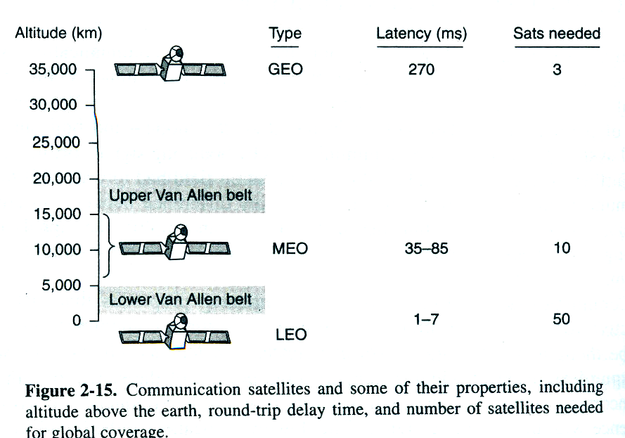
SATELLITE COMMUNICATION
DEPARTMENT OF COMPUTER SCIENCE, SARDAR PATEL UNIVERSITY, V. V. NAGAR.

Slide 23
SATELLITE COMMUNICATION
DEPARTMENT OF COMPUTER SCIENCE, SARDAR PATEL UNIVERSITY, V. V. NAGAR.
In many VSAT systems, the microstations do not have enough power to communicate directly with one another (via the satellite, of course). Instead, a special ground, station, the hub, with a large, high-gain antenna is needed to relay traffic between VSATs. In this mode of operation, either the sender or the receiver has a large antenna and a powerful amplifier. The trade-off is a longer delay in return for having cheaper end-user stations.
An important property of satellites is that they are inherently broadcast media. It does not cost more to send a message to thousands of stations within a transponder's footprint than it does to send to one. For some applications, this property is very useful. For example, one could imagine a satellite broadcasting popular Web pages to the caches of a large number of computers spread over a wide area. Even when broadcasting can be simulated with point-to-point lines, satellite broadcasting may be much cheaper. On the other hand, from a security and privacy point of view, satellites are a complete disaster: everybody can hear everything. Encryption is essential when security is required.

Slide 24
SATELLITE COMMUNICATION
DEPARTMENT OF COMPUTER SCIENCE, SARDAR PATEL UNIVERSITY, V. V. NAGAR.
Satellites also have the property that the cost of transmitting a message is independent of the distance traversed. A call across the ocean costs no more to service than a call across the street. Satellites also have excellent error rates and can be deployed almost instantly, a major consideration for military communication.

